Slide 1
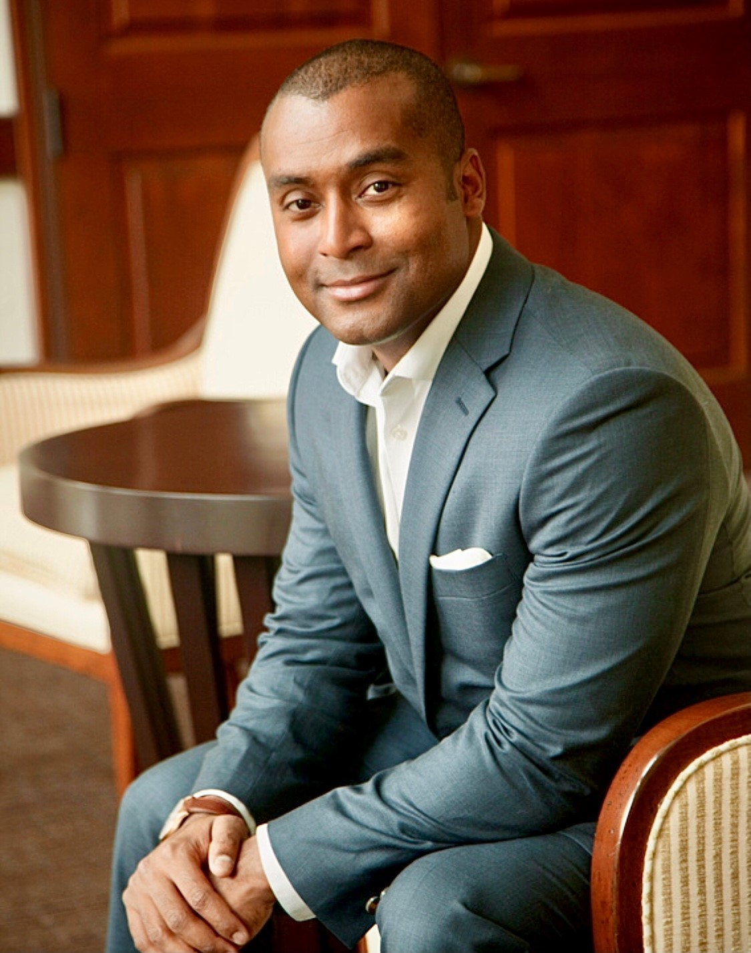
Kerryn Sarwansingh Manager — Acceleration
Email
Kerryn.sarwansingh@thebridge.com
Location
DFW, Texas
Mobile
(580) 402-2082
Kerryn became a part of The Bridge team in August 2024, bringing valuable experience from his background at top global consulting firms. His expertise spans multiple industries, and he excels at combining creativity with strategic insight to lead transformative initiatives and achieve outstanding outcomes
EXPERIENCE
Industry Experience
Government | Healthcare | Financial Services
Accenture
Government Strategy & Implementation
Primary deployment project owner on the deployment of a $5.5B initiative, collaborating with multiple government agencies to provide strategic guidance on the implementation of new technologies and resources for the Department of Defense
Manage and provide guidance to cross functional teams of associates from multiple private firms spanning 23 global federal sites, ensuring successful execution of contract deliverables
Engagement leader on 4 current state assessments and model system reviews across 22 different solutions
M&A Technology Integration and Implementation
Supported overall delivery of technology integration and implementation for Banking LOB operations during the merger of the 9th largest bank in the United States
Developed and executed activities related to end-to-end project management, primarily in Treasury & Payments, including project plans & estimates, scoping & requirements through development, testing, implementation, and deployment
Led teams through detailed alignment of development, testing, & business readiness milestones to complete program-wide replanning effort
Deloitte
Project Coordinator
Provided direct support for the Risk & Financial advisory National Managing Director, liaison between Chief of Staff and multiple multinational Oil & Gas corporations
Monitored project progress and provided status updates to internal stakeholders and project team holders
BACKGROUND
Functional Skills
Project Management, Account Management, Estimation and Planning, Organizational Strategy, Change Management, Risk Management, Business Development, Agile Team Practices, Research Analysis
Qualifications
Kerryn is an accomplished management consultant with extensive expertise in leading large-scale technology deployments and strategic initiatives across various industries, including defense and banking. He has a passion for providing strategic direction and ensuring seamless execution and delivery. With a proven track record in managing global operations, particularly in government and defense sectors, Kerryn has been recognized for driving transformative result and spearheading operations to optimize outcomes

